Slide 1
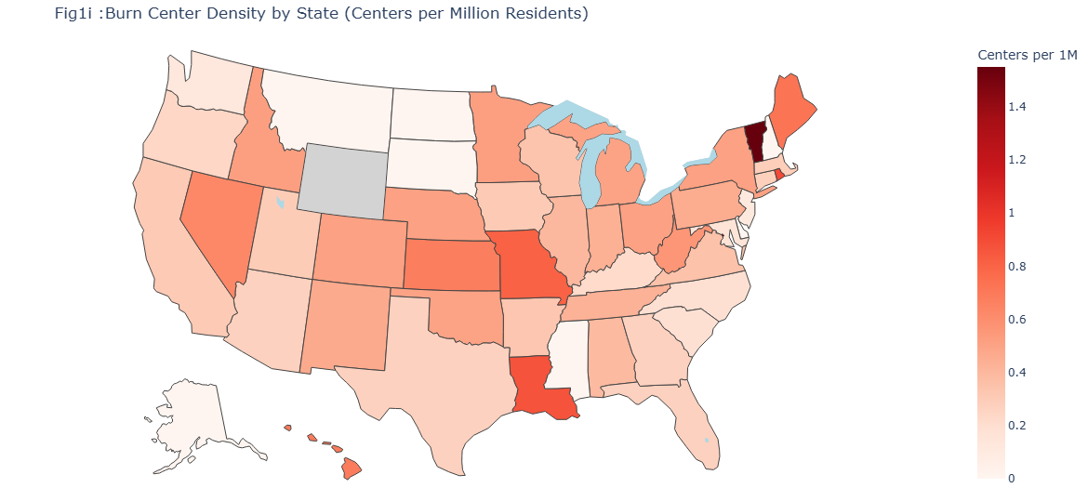
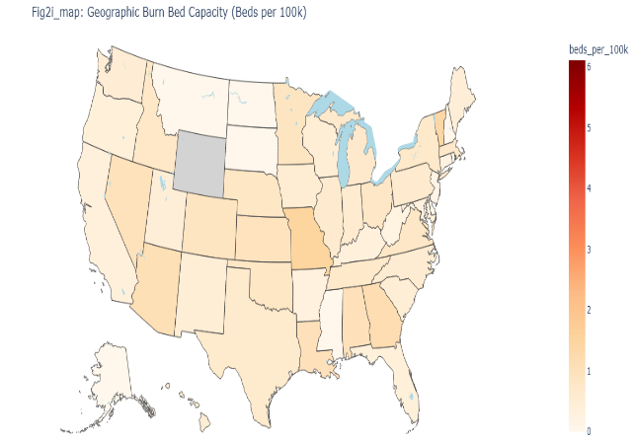
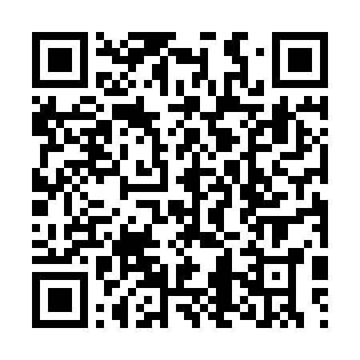
The Geography of Survival
Your zip code shouldn't be your death warrant, but for burn victims, it is.
The Reality: Access to specialized care is a "Zip Code Lottery."
The Mission: Identify "Burn Deserts" and bridge the equity gap through data-driven resource allocation.
Team 13
Check out more details Please scan QRcode
Rural burn mortality is 2.3x higher than urban

Slide 2
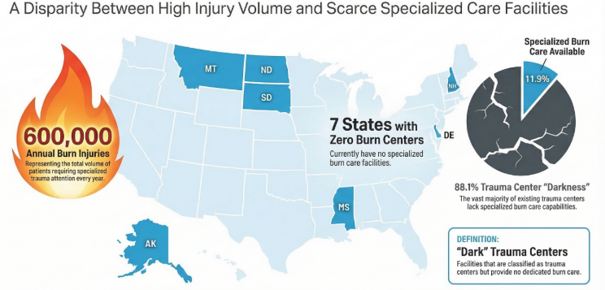
The Problem: Burn Deserts
Critical Scarcity: 7 U.S. states have zero adult burn centers (AK, DE, MS, MT, ND, NH, SD).
The"Silo" Effect: 88% of trauma centers operate without specialized burn capabilities.
Systemic Failure: Geographic isolation creates "hidden" disparities that traditional healthcare metrics overlook.

Slide 3
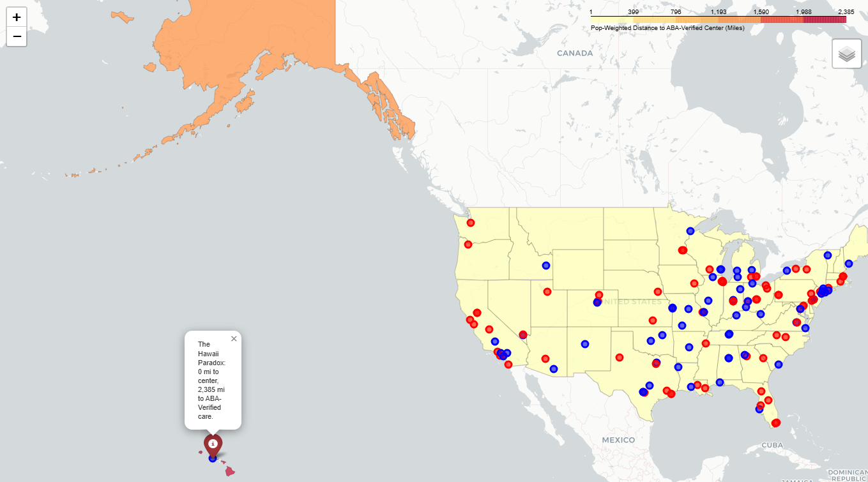
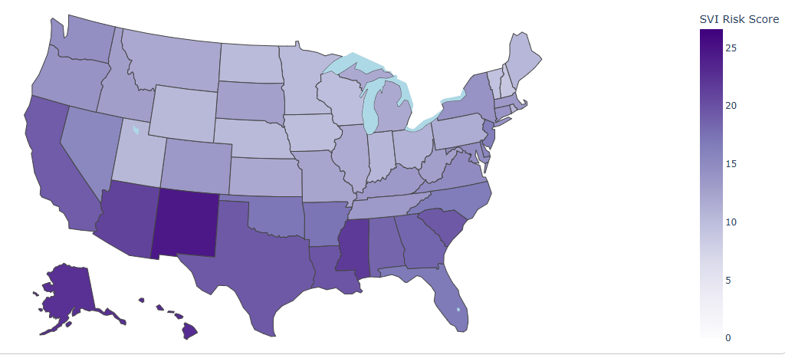
Methodology: The CVI
Clinical Vulnerability Index (SVI + Distance + Capacity)
Beyond Distance: We don't just measure miles; we measure vulnerability.
The Formula: CVI = [SVI (Social Vulnerability)] + [Distance to Care] + [Bed Capacity].
Data Integrity: Integrated NIRD 2023 hospital data with Census 2020 population centroids and CDC SVI scores.
Notes:
SVI vs. Distance (Positive Correlation): States with higher social vulnerability (specifically higher poverty and lower vehicle ownership) tend to have significantly higher distances to burn centers. This confirms that transportation-poor populations are also the most geographically isolated.
Distance vs. Bed Capacity (Negative Correlation): Areas with the greatest distances often have the lowest bed densities. This means if a patient finally travels 150 miles, they are arriving at a center that is more likely to be at full capacity.
SVI vs. Bed Capacity (Negative Correlation): Socially vulnerable states (like the 7 "Zero-Center" states identified in your PPT) have the lowest normalized bed counts.

Slide 4
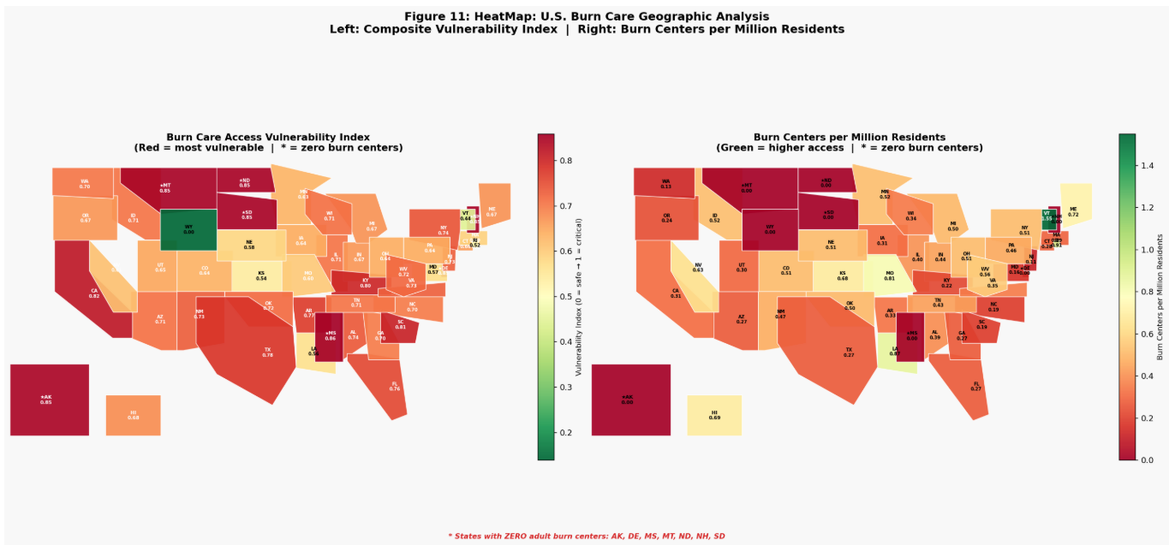
Mapping the Gap
The "Failure Zone": High-population areas located far from care centers (The "Dark Blue" states).
The Trend: Access is concentrated in urban hubs, leaving rural and minority-heavy populations stranded.
Finding: 15 states show a population-weighted distance burden exceeding 100 miles.

Slide 5
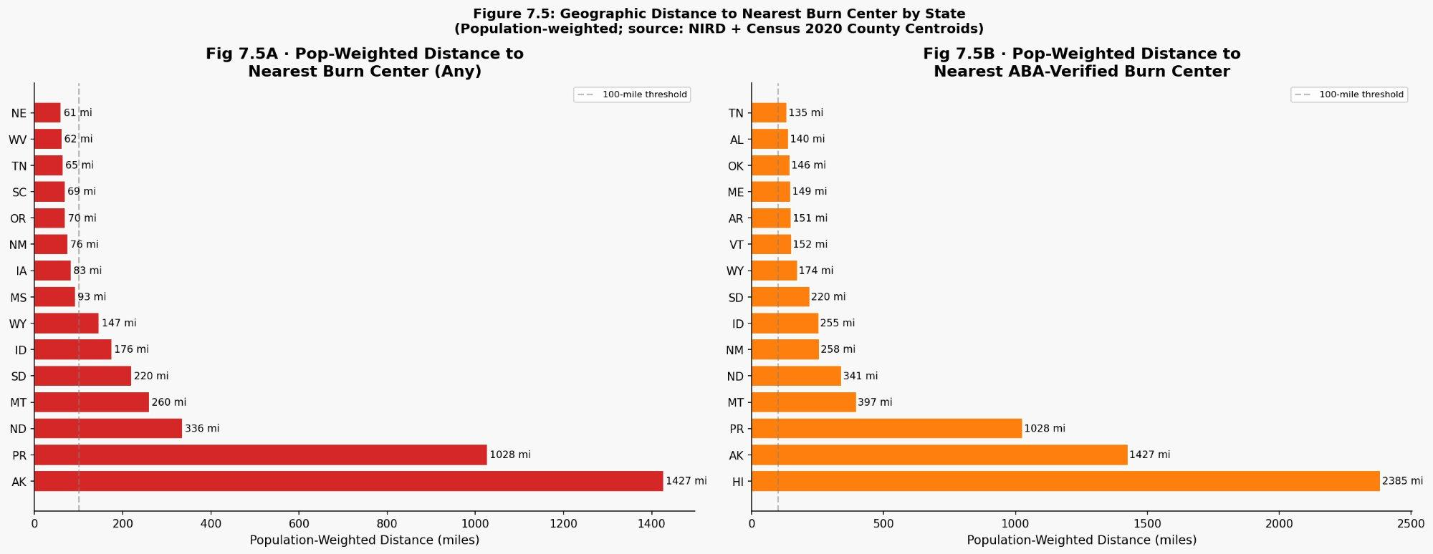
The 100-Mile Burden
The Golden Hour: Burn care is time-sensitive; a 100-mile trip is a clinical risk, not just an inconvenience.
Pediatric Crisis: Pediatric care gaps are even wider than adult gaps in 22 states.
Quality vs. Proximity: Having "any" center isn't enough; ABA-verified quality centers are even further away.
Source: NIRD 2023, ABA National Burn Repository

Slide 6
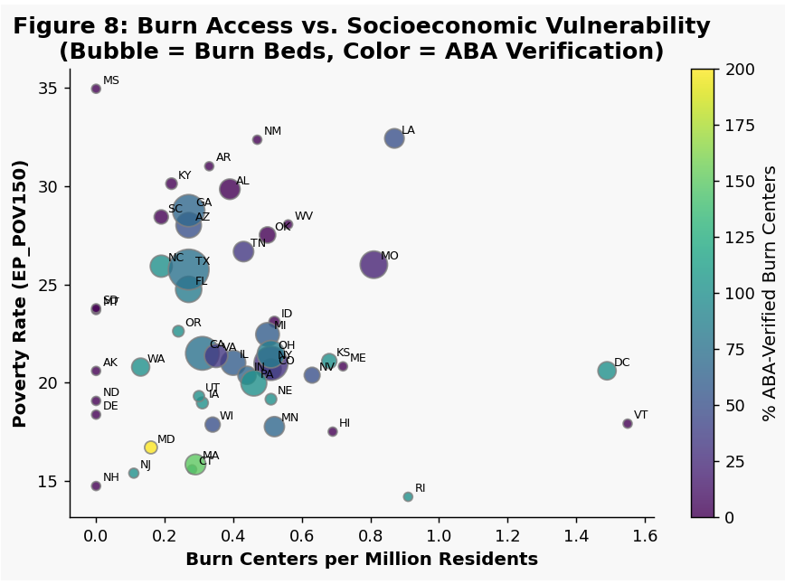
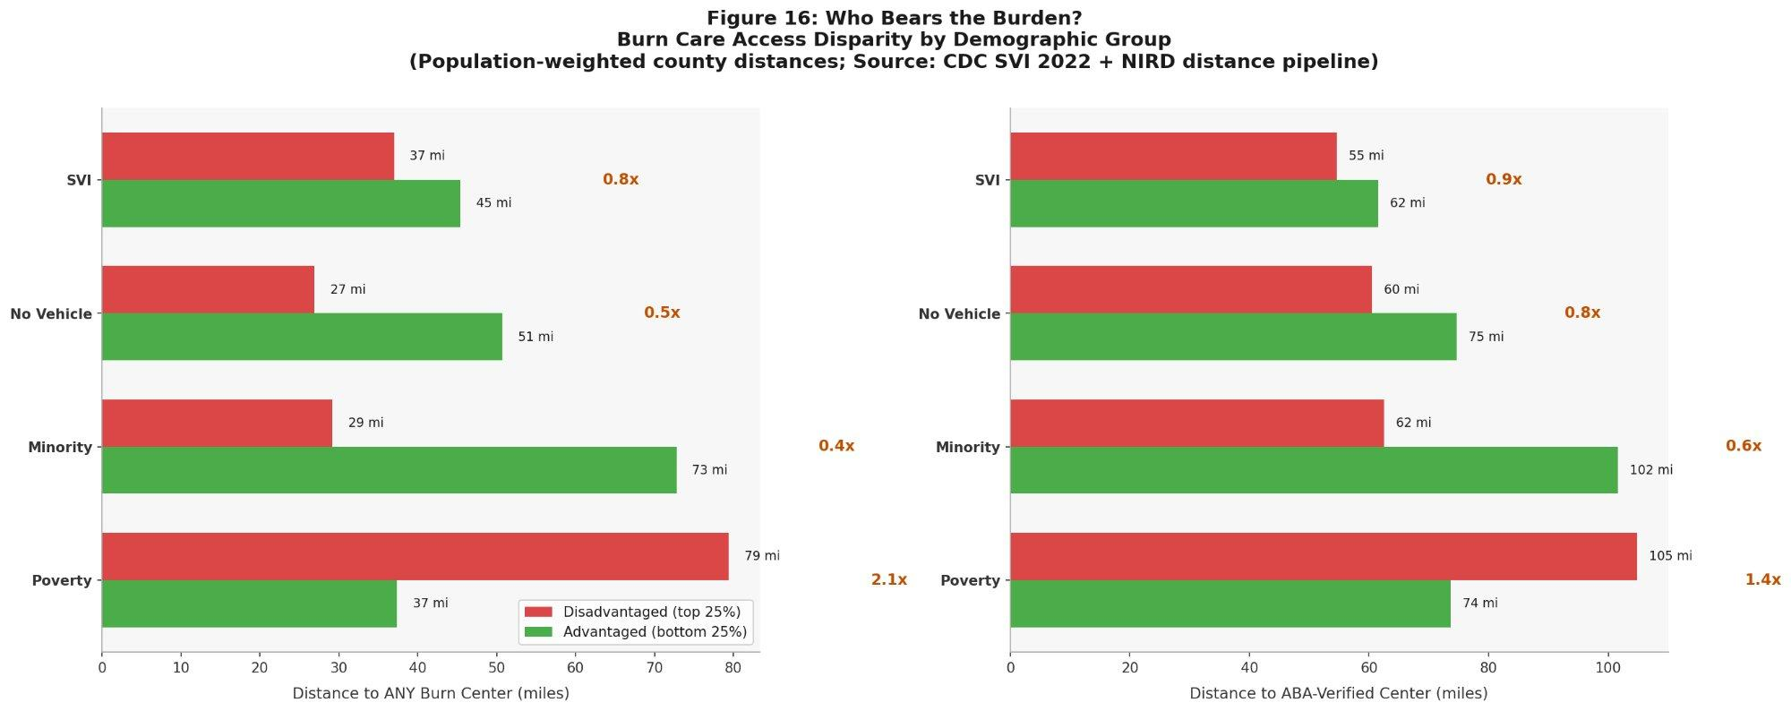
Inequity by Design
Correlation: High SVI (poverty, lack of transport) directly correlates with the longest travel times.
Compounding Factors: Families with "no vehicle" (SVI variable) are the same ones living in burn deserts.
Structural Barrier: The system assumes patients can travel; the data proves they cannot.
Figure 8: Higher SVI correlates with longer travel times and fewer verified burn beds
Figure 16: Minority and rural populations bear disproportionately longer travel distances.

Slide 7
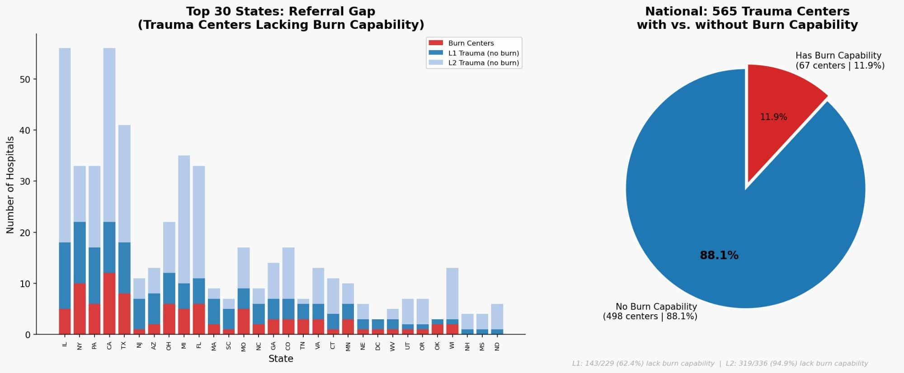
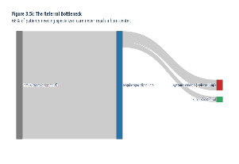
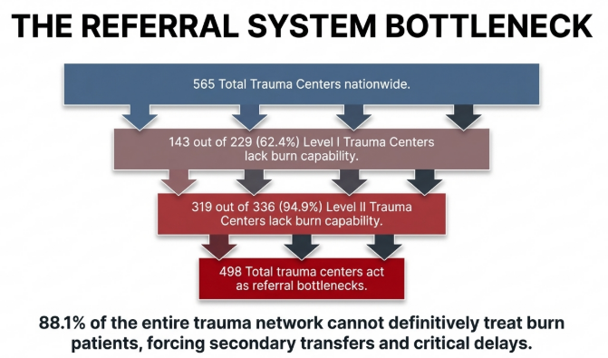
The Referral Bottleneck
The Leak: 66% of patients who meet ABA referral criteria are never transferred to a burn center.
The Cost of "Staying Local": Sub-optimal care at non-specialized centers leads to higher infection rates and longer stays.
The Bottleneck: Trauma centers are the "gatekeepers," but Only 11.9% of trauma centers can initiate burn care independently..)
This represents an estimated 12,000+ patients annually
Notes:
600k injuries flowing into only ~20k successful referrals from the interactive graph

Slide 8
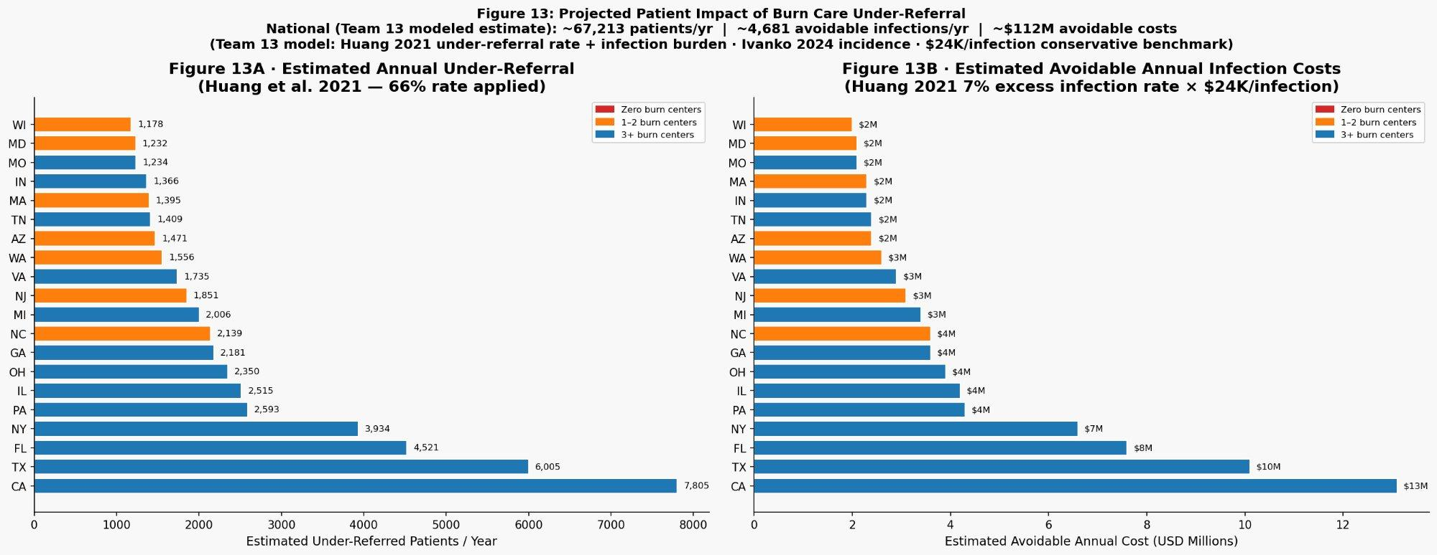
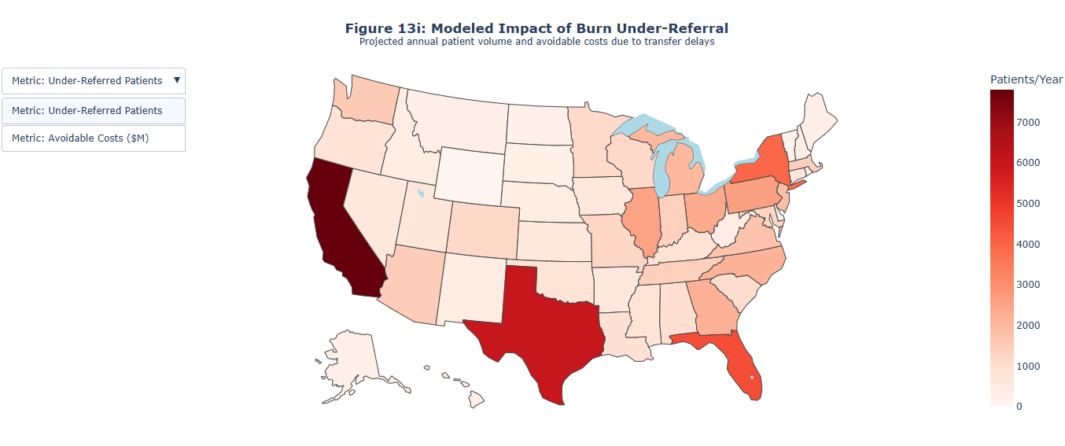
Solution 1: Tele-Burn Hubs
The Strategy: Don't move the patient; move the expertise.
Hub Identification: Use the CVI to identify Level I Trauma Centers in "Failure Zones" to serve as Tele-Burn Hubs.
Impact: Virtual triage can reduce unnecessary transfers and provide expert guidance in the first 60 minutes.
Figure 13: Tele-Burn Hubs reduce under-referral from 66% to an estimated 20% based on pilot data (simulated)
Before (Current) | After (Tele-Burn Hub)
Patient arrives at non-burn trauma center | Same patient
No burn specialist on-site | Virtual consult via Tele-Burn Hub
66% never transferred → delayed or no burn care | Expert triage in first 60 minutes
High unnecessary transfers | Reduced unnecessary transfers
Notes:
Identified the Level I Trauma Centers that do not currently have burn units. These are the bridge between the current desert and future care.

Slide 9
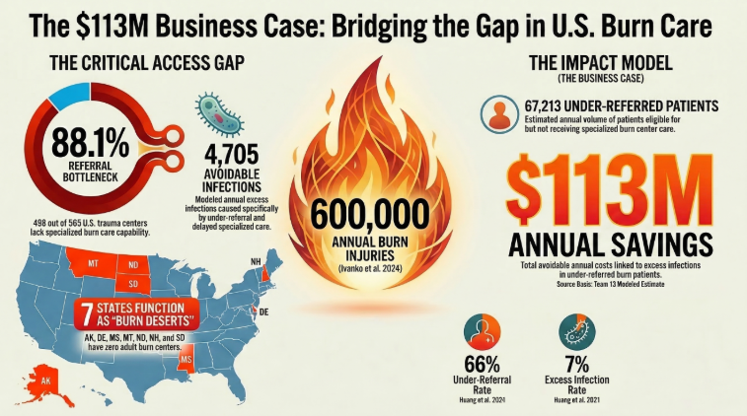
Solution 2: Policy & Impact
The Projection: Closing the referral gap could save ~$113M annually in excess infection costs.
Breakdown: $78M from reduced infections + $35M from avoided transfers
Clinical Gain: 7% reduction in secondary infections by standardizing care via telemedicine.
Scale: This isn't just a clinical fix; it's a multi-billion dollar efficiency opportunity for the US healthcare system.
Notes:
identified the Level I Trauma Centers that do not currently have burn units.

Slide 10
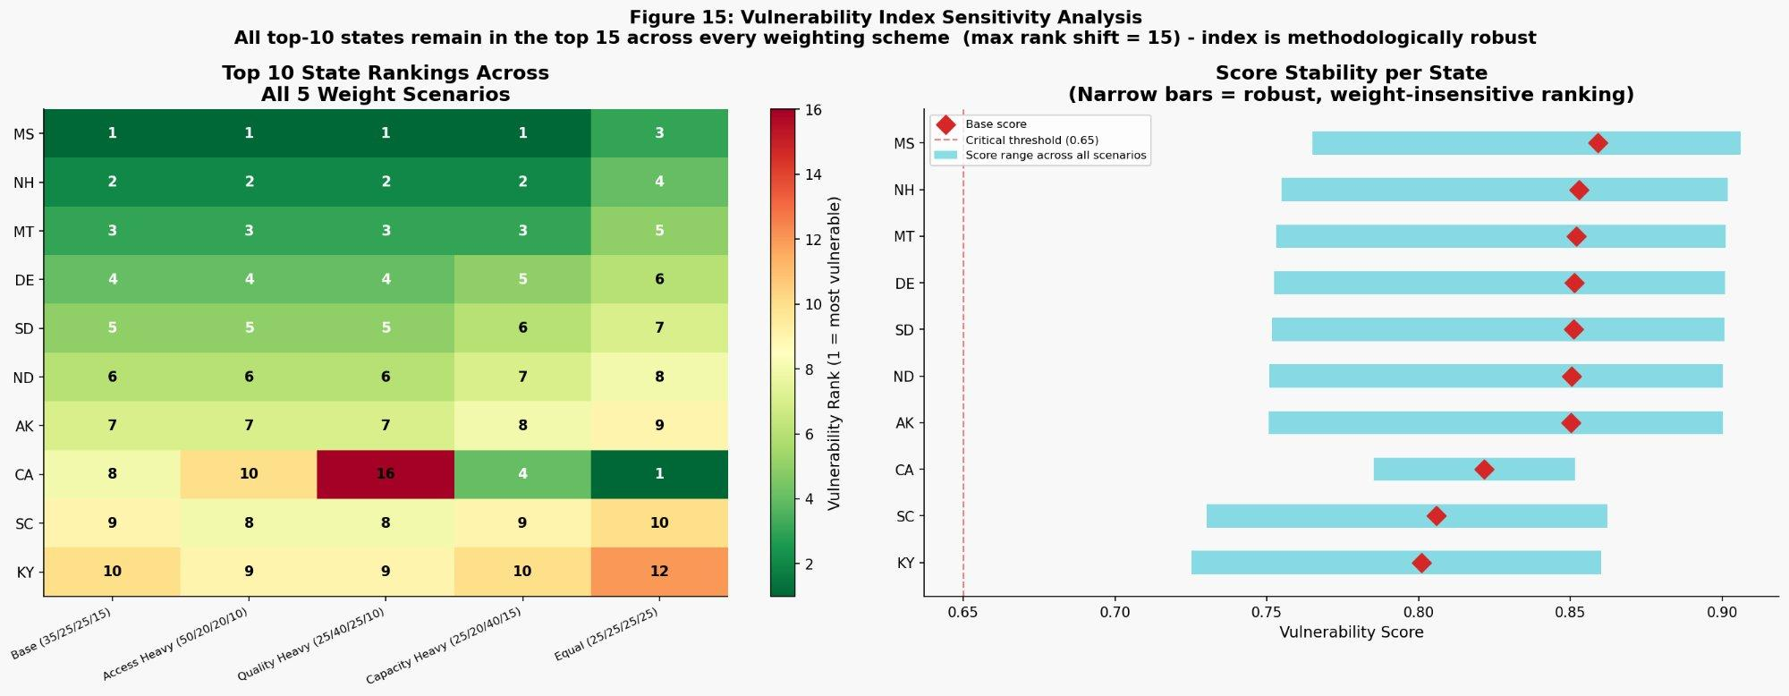
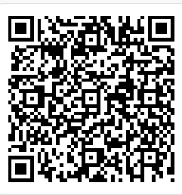
The Future of Access
Final Call: Turn "Burn Deserts" into "Connected Care Networks."
The Vision: Federal and ABA partnership to anchor new centers in the 7 "Zero-Center" states.
Data has identified the gap. Technology must now bridge it.
For more interactive graph details , please scan the QR code.
Notes:
It shows that no matter how you look at the data, the same 10 states need help. It makes your recommendation "undeniable."

